Slide 1
Topic Troubleshooting
CCNA Routing and Switching
200-120 Examination
Jeng-Yueng Chen
Hsiuping University of Science and Technology

Slide 2
252

Slide 3
253

Slide 4
254
Refer to the exhibit. A network administrator attempts to ping Host2 from Host1 and receives the results that are shown. What is the problem?

Slide 5
254
The link between Host1 and Switch1 is down.
TCP/IP is not functioning on Host1
The link between Router1 and Router2 is down.
The default gateway on Host1 is incorrect.
Interface Fa0/0 on Router1 is shutdown.
The link between Switch1 and Router1 is down.

Slide 6
255
Refer to the exhibit. Hosts in network 192.168.2.0 are unable to reach hosts in network 192.168.3.0. Based on the output from RouterA, what are two possible reasons for the failure? (Choose two.)

Slide 7
255
The cable that is connected to S0/0 on RouterA is faulty.
Interface S0/0 on RouterB is administratively down.
Interface S0/0 on RouterA is configured with an incorrect subnet mask.
The IP address that is configured on S0/0 of RouterB is not in the correct subnet.
Interface S0/0 on RouterA is not receiving a clock signal from the CSU/DSU.
The encapsulation that is configured on S0/0 of RouterB does not match the encapsulation that is configured on S0/0 of RouterA.

Slide 8
256
Refer to the exhibit. An administrator pings the default gateway at 10.10.10.1 and sees the output as shown. At which OSI layer is the problem?
data link layer
application layer
access layer
session layer
network layer

Slide 9
257
Refer to the exhibit. The two connected ports on the switch are not turning orange or green. What would be the most effective steps to troubleshoot this physical layer problem? (Choose three.)
Ensure that the Ethernet encapsulations match on the interconnected router and switch ports.
Ensure that cables A and B are straight-through cables.
Ensure cable A is plugged into a trunk port.
Ensure the switch has power.
Reboot all of the devices.
Reseat all cables.

Slide 10
258
Refer to the exhibit. The network shown in the diagram is experiencing connectivity problems. Which of the following will correct the problems? (Choose two.)

Slide 11
258
Configure the gateway on Host A as 10.1.1.1.
Configure the gateway on Host B as 10.1.2.254.
Configure the IP address of Host A as 10.1.2.2.
Configure the IP address of Host B as 10.1.2.2.
Configure the masks on both hosts to be 255.255.255.224.
Configure the masks on both hosts to be 255.255.255.240.

Slide 12
259
Refer to the exhibit. A problem with network connectivity has been observed. It is suspected that the cable connected to switch port Fa0/9 on Switch1 is disconnected. What would be an effect of this cable being disconnected?

Slide 13
259
Host B would not be able to access the server in VLAN9 until the cable is reconnected.
Communication between VLAN3 and the other VLANs would be disabled.
The transfer of files from Host B to the server in VLAN9 would be significantly slower.
For less than a minute, Host B would not be able to access the server in VLAN9. Then normal network function would resume.

Slide 14
260
Refer to the exhibit. HostA cannot ping HostB. Assuming routing is properly configured, what is the cause of this problem?

Slide 15
260
HostA is not on the same subnet as its default gateway.
The address of SwitchA is a subnet address.
The Fa0/0 interface on RouterA is on a subnet that can't be used.
The serial interfaces of the routers are not on the same subnet.
The Fa0/0 interface on RouterB is using a broadcast address.

Slide 16
261
Which router IOS commands can be used to troubleshoot LAN connectivity problems? (Choose three.)
ping
tracert
ipconfig
show ip route
winipcfg
show interfaces

Slide 17
262
A network administrator is troubleshooting the OSPF configuration of routers R1 and R2. The routers cannot establish an adjacency relationship on their common Ethernet link. The graphic shows the output of the show ip ospf interface e0 command for routers R1 and R2. Based on the information in the graphic, what is the cause of this problem?

Slide 18
262
The OSPF area is not configured properly.
The priority on R1 should be set higher.
The cost on R1 should be set higher.
The hello and dead timers are not configured properly.
A backup designated router needs to be added to the network.
The OSPF process ID numbers must match.

Slide 19
263
In which circumstance are multiple copies of the same unicast frame likely to be transmitted in a switched LAN?
during high traffic periods
after broken links are re-established
when upper-layer protocols require high reliability
in an improperly implemented redundant topology
when a dual ring topology is in use

Slide 20
264 Skill

Slide 21
264 Skill

Slide 22
264 Skill

Slide 23
264 Skill

Slide 24
264 Skill
Which will fix the issue and allow ONLY ping to work while keeping telnet disabled?
Correctly assign an IP address to interface fa0/1.
Change the ip access-group command on fa0/0 from "in* to "out.
Remove access-group 106 in from interface fa0/0 and add access-group 115 in.
Remove access-group 102 out from interface s0/0/0 and add access-group 114 in
Remove access-group 106 in from interface fa0/0 and add access-group 104 in.

Slide 25
265 Skill

Slide 26
265 Skill

Slide 27
265 Skill

Slide 28
265 Skill

Slide 29
265 Skill
What would be the effect of issuing the command ip access-group 114 in to the fa0/0 interface?
Attempts to telnet to the router would fail.
It would allow all traffic from the 10.4.4.0 network.
IP traffic would be passed through the interface but TCP and UDP traffic would not.
Routing protocol updates for the 10.4.4.0 network would not be accepted from the fa0/0 interface.

Slide 30
266 Skill

Slide 31
266 Skill

Slide 32
266 Skill

Slide 33
266 Skill
What would be the effect of Issuing the command ip access-group 115 in on the s0/0/1 interface?
No host could connect to RouterC through s0/0/1.
Telnet and ping would work but routing updates would fail.
FTP, FTP-DATA, echo, and www would work but telnet would fail.
Only traffic from the 10.4.4.0 network would pass through the interface.

Slide 34
267 Skill

Slide 35
268 Skill

Slide 36
269 Skill
Central Florida Widgets recently installed a new router in their office. Complete the network installation by performing the initial router configurations and configuring R1PV2 routing using the router command line interface (CLI) on the RC.

Slide 37
270 Skill

Slide 38
271 Skill

Slide 39
272 Skill

Slide 40
NetFlow Overview
NetFlow is an application for collecting IP traffic information.
Reports from NetFlow are like a phone bill.
NetFlow enables the following:
Measuring who uses network resources
Accounting and charging for resource utilization
Using the measured information to do effective network planning
Using the measured information to customize applications and services
Notes:
NetFlow is a Cisco IOS application that provides statistics on packets flowing through the routing devices in the network. It is emerging as a primary network accounting and security technology.
Cisco IOS NetFlow efficiently provides a key set of services for IP applications, including network traffic accounting, usage-based network billing, network planning, security, DoS monitoring capabilities, and network monitoring.
NetFlow technology creates an environment in which you have the tools to understand how network traffic is flowing. To use an analogy from the telephone industry, NetFlow is like a phone bill, from which you can learn who is talking to whom, how frequently, how long, and so on.
NetFlow is completely transparent to the existing network, including end stations and application software, and network devices such as LAN switches. Also, NetFlow capture and export are performed independently on each internetworking device. NetFlow does not need to be operational on each router in the network.
NetFlow is important for service providers and enterprise customers because it helps address four key requirements:
- Efficiently measuring who is using which network resources for which purpose
- Accounting and charging back according to the resource utilization level
- Using the measured information to do more effective network planning so that resource allocation and deployment are well-aligned with customer requirements
- Using the information to better structure and customize the set of available applications and services to meet user needs and customer service requirements

Slide 41
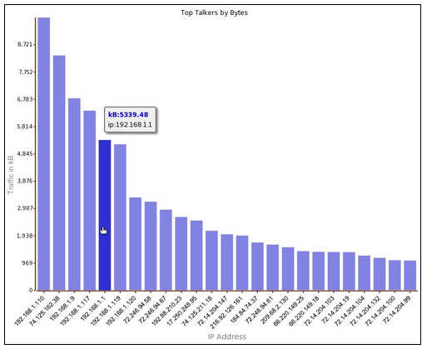
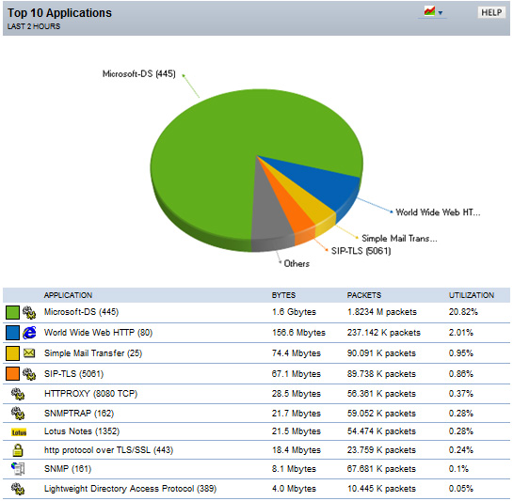
NetFlow Overview
Example of analysis on a NetFlow collector:
Shows top talkers, top listeners, top protocols, and more.
Notes:
There are several NetFlow collectors and analyzers available on the market. These tools enable you to analyze the traffic on your network by showing the top talkers, top listeners, top protocols, and more. You can see the types of traffic (web, mail, FTP, peer-to-peer, and so on) that are on the network, as well as which devices are sending and receiving most of the traffic. Collecting data provides you with forensic-level telemetry on top talkers, top hosts, and top listeners. And because data is preserved over time, you will be able to analyze network usage trends.
Based on the usage of NetFlow analyzers, you will be able to identify the following:
- The major users of the network
- The websites that are routinely visited and what is downloaded
- Who is generating the most traffic
- If you have enough bandwidth to support mission-critical activity
- Who is using excessive bandwidth

Slide 42
NetFlow Overview
NetFlow components:
NetFlow-enabled network devices
NetFlow collector
NetFlow devices generate NetFlow records that are exported and then collected by a NetFlow collector. Cisco Network Analysis Module is an example of a NetFlow collector. It also processes NetFlow data and provides the results through its GUI.
NetFlow-Enabled Router
NetFlow Collector
Notes:
NetFlow components include the following:
- Network devices that are configured for NetFlow
- NetFlow Collector, which receives NetFlow information from network devices
Network devices collect IP traffic statistics on interfaces where NetFlow is configured. Network devices then export these statistics as NetFlow records to a central server that runs NetFlow Collector software. The Collector also performs traffic analysis.

Slide 43
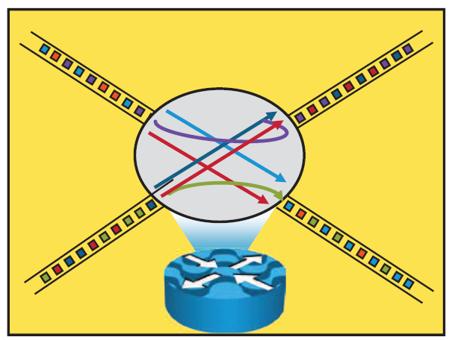
NetFlow Overview
Cisco defines a flow as a unidirectional sequence of packets with seven common values:
Source IP address
Destination IP address
Source port number
Destination port number
Layer 3 protocol type
ToS
Input logical interface
Notes:
A NetFlow network flow is defined as a unidirectional stream of packets between a given source and destination. The source and destination are each defined by a network layer IP address and transport layer source and destination port numbers.
A flow is defined by the combination of seven key fields, which define a unique flow. If a packet has one key field that is different from another packet, it is considered to belong to another flow. Flows are stored in the NetFlow cache.
Note ToS is a field in the IP header. It is used as a quality of service (QoS) mechanism to mark IP packets with different priorities in
order to receive different treatment in terms of throughput, reliability, and latency.

Slide 44
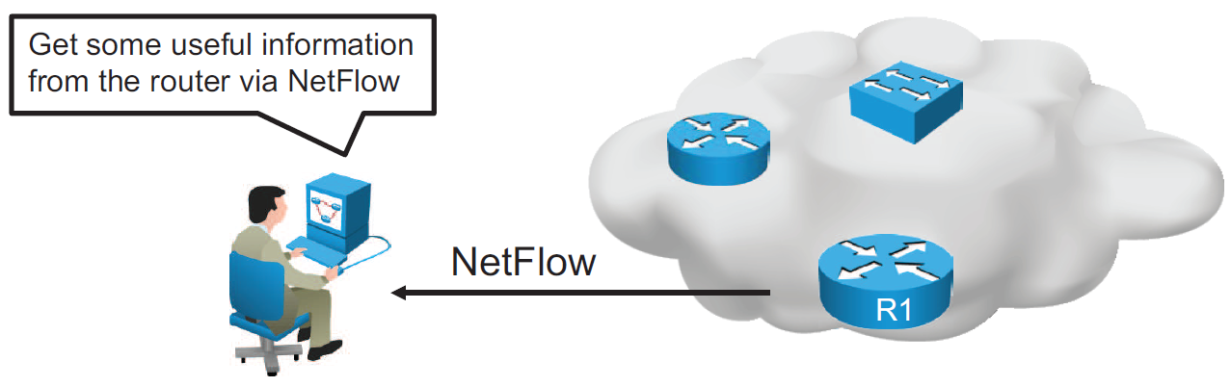
NetFlow Configuration
Configure NetFlow data capture
Configure NetFlow data export
Configure NetFlow data export version
Verify NetFlow, its operation, and statistics
Notes:
To implement NetFlow on a router, you must do the following:
Configure NetFlow data capture: NetFlow can capture data from ingress (incoming) and egress (outgoing) packets.
Configure NetFlow data export: You need to specify the IP address or hostname of the NetFlow collector and the UDP port that the NetFlow collector listens to. Optionally, you can specify an interface to use for the source IP address of the packet sent to the collector.
Configure NetFlow data export version: You can specify the version of NetFlow data export format.
Verify NetFlow, its operation, and statistics: After you have configured NetFlow, you can analyze the exported data on a workstation running an application such as NetFlow Collection Engine or using several show commands on the router itself.
Note Be aware that NetFlow consumes additional memory. If you have memory constraints, you can preset the size of the NetFlow cache so that it contains a smaller number of entries. The default cache size depends on the platform.

Slide 45
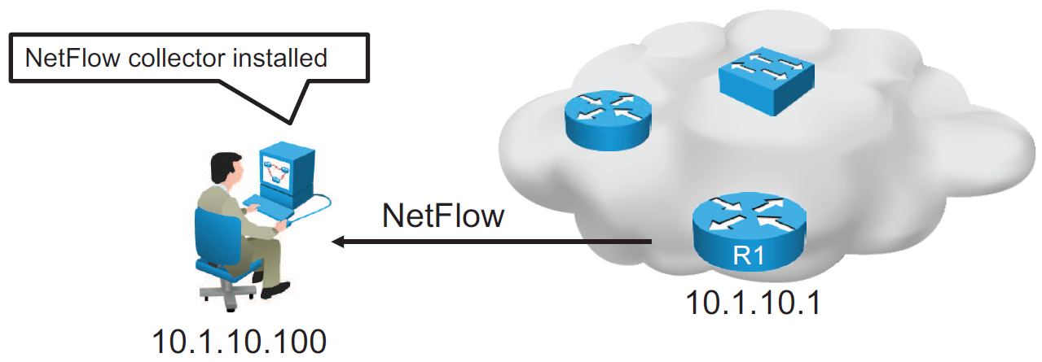
NetFlow Configuration (Cont.)
R1(config)# interface GigabitEthernet0/0
R1(config-if)# ip flow ingress
R1(config-if)# ip flow egress
R1(config-if)# exit
R1(config)# ip flow-export destination 10.1.10.100 9996
R1(config)# ip flow-export version 9
Configuration of NetFlow on router R1
Notes:
Configuration of NetFlow is based on the following commands:
ip flow {ingress | egress}
Enables NetFlow on the interface. Captures traffic that is being received or being transmitted by the interface.
ip flow-export destination ip-address udp-port
IP address of the workstation to which you want to send the NetFlow information and the number of the UDP port on which the workstation is listening for this input. UDP port 9996 is commonly used for NetFlow.
ip flow-export version version
Specifies the version format that the export packet uses.
The figure shows configurations for NetFlow data capture and data export to NetFlow collector with IP address 10.1.10.100, where you can analyze the exported data.
Traffic that is being either received or transmitted by the GigabitEthernet 0/0 interface is captured using the ip flow command. Captured NetFlow information is then sent to the collector with IP address 10.1.10.100 on UDP port 9996. The ip flow-export version command specifies that the export packet uses the version 9 format.
Note NetFlow exports data in UDP in one of five formats (1, 5, 7, 8, and 9). Version 9 is the most versatile data export format but is not backward compatible with version 8 or version 5.

Slide 46
NetFlow Configuration (Cont.)
R1# show ip flow interface
GigabitEthernet0/0
ip flow ingress
ip flow egress
Displays if NetFlow is enabled on an interface
R1# show ip flow export
Flow export v9 is enabled for main cache
Export source and destination details :
VRF ID : Default
Destination(1) 10.1.10.100 (9996)
Version 9 flow records
43 flows exported in 15 udp datagrams
Displays the status and the statistics for NetFlow data export
Notes:
You can use the show ip flow interface command to verify if NetFlow is enabled on an interface. In the example, NetFlow is enabled in the ingress and egress directions on the GigabitEthernet0/0 interface.
Use the show ip flow export command to verify the status and statistics for NetFlow accounting data export. In the example, the configured destination for NetFlow export is 10.1.10.100 using UDP port 9996. The version of the configured flow export is 9.

Slide 47
NetFlow Configuration (Cont.)
R1# show ip cache flow
<output omitted>
IP Flow Switching Cache, 278544 bytes
2 active, 4094 inactive, 31 added
6374 ager polls, 0 flow alloc failures
Active flows timeout in 30 minutes
Inactive flows timeout in 15 seconds
IP Sub Flow Cache, 34056 bytes
2 active, 1022 inactive, 31 added, 31 added to flow
0 alloc failures, 0 force free
1 chunk, 0 chunks added
last clearing of statistics 00:49:48
Protocol Total Flows Packets Bytes Packets Active(Sec) Idle(Sec)
-------- Flows /Sec /Flow /Pkt /Sec /Flow /Flow
TCP-Telnet 19 0.0 19 58 0.1 6.5 11.7
TCP-WWW 14 0.0 8 202 0.0 0.0 1.5
TCP-other 2 0.0 19 98 0.0 2.2 8.9
<output omitted>
SrcIf SrcIPaddress DstIf DstIPaddress Pr SrcP DstP Pkts
Gi0/1 172.16.1.100 Gi0/0 10.2.23.105 01 0401 0017 1341
Displays a summary of the NetFlow accounting statistics
Notes:
You can use the show ip cache flow command to display a summary of NetFlow statistics on a Cisco IOS router. Using this command, you can see which protocols use the highest volume of traffic and between which hosts this traffic flows.
The example shows a summary of NetFlow statistics on the R1 router. Note that the destination port is hex 17, which is equal to decimal 23, the well-known TCP port for Telnet services.

Slide 48
273
What are three reasons to collect Netflow data on a company network? (Choose three.)
To identify applications causing congestion.
To authorize user network access.
To report and alert link up / down instances.
To diagnose slow network performance, bandwidth hogs, and bandwidth utilization.
To detect suboptimal routing in the network.
To confirm the appropriate amount of bandwidth that has been allocated to each Class of Service.

Slide 49
274
What Netflow component can be applied to an interface to track IPv4 traffic?
flow monitor
flow record
flow sampler
flow exporter

Slide 50
275
What Cisco IOS feature can be enabled to pinpoint an application that is causing slow network performance?
SNMP
Netflow
WCCP
IP SLA

Slide 51
276
What command visualizes the general NetFlow data on the command line?
show ip flow export
show ip flow top-talkers
show ip cache flow
show mls sampling
show mls netflow ip

Slide 52
277
What are three values that must be the same within a sequence of packets for Netflow to consider them a network flow? (Choose three.)
source IP address
source MAC address
egress interface
ingress interface
destination IP address
IP next-hop

Slide 53
278
What are three factors a network administrator must consider before implementing Netflow in the network? (Choose three.)
CPU utilization
where Netflow data will be sent
number of devices exporting Netflow data
port availability
SNMP version
WAN encapsulation

Slide 54
279
Refer to the exhibit.

Slide 55
279
If the devices produced the given output, what is the cause of the EtherChannel problem?
SW1's Fa0/1 interface is administratively shut down.
There is an encapsulation mismatch between SW1's Fa0/1 and SW2's Fa0/1 interfaces.
There is an MTU mismatch between SW1's Fa0/1 and SW2's Fa0/1 interfaces.
There is a speed mismatch between SW1's Fa0/1 and SW2's Fa0/1 interfaces.

Slide 56
280
What are the benefit of using Netflow? (Choose three.)
Network, Application & User Monitoring
Network Planning
Security Analysis
Accounting/Billing

Slide 57
281
Which protocol can cause overload on a CPU of a managed device?
Netflow
WCCP
IP SLA
SNMP
NetFlow is an application not a protocol

Slide 58
282
What are the three things that the Netflow uses to consider the traffic to be in a same flow? (Choose three)
IP address
Interface name
Port numbers
L3 protocol type
MAC address

Slide 59
283 Skill

Slide 60
283 Skill
An OSPF neighbor adjacency is not formed between R3 in the main office and R4 in the Branch1 office. What is causing the problem?
There is an area ID mismatch.
There is a Layer 2 issue; an encapsulation mismatch on serial links.
There is an OSPF hello and dead interval mismatch.
The R3 router ID is configured on R4.

Slide 61
284 Skill

Slide 62
284 Skill
An OSPF neighbor adjacency is not formed between R3 in the main office and R5 in the Branch2 office. What is causing the problem?
There is an area ID mismatch.
There is a PPP authentication issue; a password mismatch.
There is an OSPF hello and dead interval mismatch.
There is a missing network command in the OSPF process on R5.

Slide 63
285 Skill

Slide 64
285 Skill
R1 does not form an OSPF neighbor adjacency with R2. Which option would fix the issue?
R1 ethernet0/1 is shutdown. Configure no shutdown command.
R1 ethernet0/1 configured with a non-default OSPF hello interval of 25: configure no ip ospf hello-interval 25
R2 ethernet0/1 and R3 ethernet0/0 are configured with a non-default OSPF hello interval of 25; configure no ip ospf hello-interval 25
Enable OSPF for R1 ethernet0/1; configure ip ospf 1 area 0 command under ethernet0/1

Slide 65
286 Skill

Slide 66
286 Skill
An OSPF neighbor adjacency is not formed between R3 in the main office and R6 in the Branch3 office. What is causing the problem?
There is an area ID mismatch.
There is a PPP authentication issue; the username is not configured on R3 and R6.
There is an OSPF hello and dead interval mismatch.
The R3 router ID is configured on R6.

Slide 67
287 Skill

Slide 68
287 Skill
The loopback interfaces on R4 with the IP addresses of 10.4.4.4 /32, 10.4.4.5/32. and 10.4.4.6/32 are not appearing in the routing table of R5 Why are the interfaces missing?
The interfaces are shutdown, so they are not being advertised.
R4 has been incorrectly configured to be in another AS, so it does not peer with R5.
Automatic summarization is enabled, so only the 10.0.0.0 network is displayed.
The loopback addresses haven't been advertised, and the network command is missing on R4.

Slide 69
288 Skill

Slide 70
288 Skill
Which path does traffic take from R1 to R5?
The traffic goes through R2.
The traffic goes through R3.
The traffic is equally load-balanced over R2 and R3.
The traffic is unequally load-balanced over R2 and R3.

Slide 71
289 Skill

Slide 72
289 Skill
Router R6 does not form an EIGRP neighbor relationship correctly with router R1. What is the cause for this misconfiguration?
The K values mismatch.
The AS does not match.
The network command is missing.
The passive-interface command is enabled.

Slide 73
290 Skill

Slide 74
290 Skill
Why are the pings failing?
The network statement is missing on R5.
The loopback interface is shut down on R5.
The network statement is missing on R1.
The IP address that is configured on the Lo1 interface on R5 is incorrect.

